Slide 1
Lecture # 15
Mealy Machine
Examples
Complementing machine
Incrementing Machine

Slide 2
Mealy Machine
A Mealy machine consists of the following
A finite set of states q0, q1, q2, … where q0 is the initial state.
An alphabet of letters Σ = {a,b,c,…} from which the input strings are formed.
An alphabet Γ={x,y,z,…} of output characters from which output strings are generated.
A pictorial representation with states and directed edges labeled by an input letter along with an output character. The directed edges also show how to go from one state to another corresponding to every possible input letter.
(It is not possible to give transition table in this case.)

Slide 3
Note
It is to be noted that since, similar to Moore machine, in Mealy machine no state is designated to be a final state, so there is no question of accepting any language by Mealy machine.
However in some cases the relation between an input string and the corresponding output string may be identified by the Mealy machine.
Moreover, the state to be initial is not important as if the machine is used several times and is restarted after some time, the machine will be started from the state where it was left off.

Slide 4
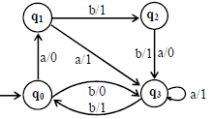
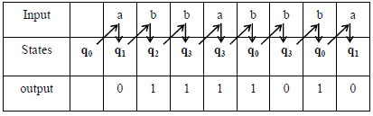
Example
Consider the Mealy machine shown aside, having the states q0, q1, q2, q3 , where q0 is the start state and Σ = {a,b}, Γ={0,1}
Running the string abbabbba over the above machine, the corresponding output string will be 11011010, which can be determined by the following table as well

Slide 5
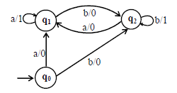
Example
Consider the following Mealy machine having the states q0, q1, q2 , where q0 is the start state and
Σ = {a,b},
Γ={0,1}
It is observed that in the above Mealy machine, if in the output string the nth character is 1, it shows that the nth letter in the input string is the second in the pair of double letter.
For babaababba as input string the machine will print 0000100010.

Slide 6

Example- Complementing Machine
Consider the following Mealy machine having the only state q0 as the start state and
Σ = {0,1},
Γ= {0,1}
If 0011010 is run on this machine then the corresponding output string will be 1100101.
This machine is called Complementing machine.

Slide 7
Constructing the Incrementing Machine
In the previous example of complementing machine, it has been observed that the input string and the corresponding output string are 1’s complement of each other.
There is a question whether the Mealy machine can be constructed, so that the output string is increased, in magnitude, by 1 than the corresponding input string?
The answer is yes.
This machine is called the incrementing machine.
Following is how to construct the incrementing machine. Before the incrementing machine is constructed, consider how 1 is added to a binary number.
Since, if two numbers are added, the addition is performed from right to left, so while increasing the binary
number by 1, the string (binary number) must be read by the corresponding Mealy machine from right to left, and hence the output string (binary number) will also be generated from right to left.

Slide 8

Consider the following additions
It may be observed from the above that if the right most bit of binary number, to be incremented, is 0, the output binary number can be obtained by converting the right most bit to 1 and remaining bits unchanged.
If the right most bit of binary number is 1 then the output can be obtained, converting that 1 along with all its concatenated 1’s to 0’s, then converting the next 0 to 1 and remaining bits unchanged.
The observations (a) and (b) help to construct the following Incrementing (Mealy) machine.

Slide 9
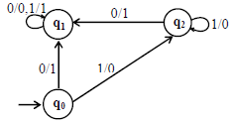
Example
The Mealy machine have the states q0, q1, q2 , where q0 is the start state and Σ = {0,1}, Γ={0,1}
It may be observed that, in the incrementing machine, if 0 is read at initial state q0, that 0 is converted to 1 and a no change state q1 (no carry state) is entered where all 0’s and all 1’s remain unchanged.
If 1 is read at initial state, that 1 is converted to 0 and the state q2(owe carry state) is entered, where all 1’s are converted to 0’s and at that state if 0 is read that 0 is converted to 1 and the machine goes to no change state.

Slide 10
Note
If the strings 100101110 and 1001100111 are run over this machine, the corresponding output strings will be 100101111 and 1001101000 respectively.
It is to be noted that if the string 111111 is run over the incrementing machine, the machine will print out 000000, which is not increased in magnitude by 1.
Such a situation is called an overflow situation, as the length of output string will be same as that of input string.

